Slide 1

Blue Jeans Pocket Size

Slide 2
introduction
If you're on social media at all, you've seen the memes or videos. It seems like such a small thing, a pocket, doesn't it?
Like people, the pockets on a pair of blue jeans come in a multitude of varying shapes and sizes

Slide 3
introduction
When I think about my favorite jeans, they're always the most comfortable ones with the best sized pockets. A lot of content online points to women's clothing either not having pockets at all, having fake pockets, or having tiny and unusable pockets. I found this to be a very interesting question and want to see how common this is. I also want to see at what magnitude pocket size varies in blue jeans, not only between genders, but also between jean styles.

Slide 4
Data Overview
Data was collected by Jan Diehm and Amber Thomas of The Pudding web publication.
Measurements of the height and width of the pockets for jeans from 20 major brands were taken inside brick-and-mortar stores for both men’s and women’s jeans and recorded on a data collection sheet.

Slide 5
Data Overview
Data was collected by Jan Diehm and Amber Thomas of The Pudding web publication.
Measurements of the height and width of the pockets for jeans from 20 major brands were taken inside brick-and-mortar stores for both men’s and women’s jeans and recorded on a data collection sheet.
To ensure proportion accuracy, all jeans measured had a 32” waistband so they all fit roughly the same sized person.
All measurements are recorded in centimeters
Data Source

Slide 6
Data Overview
Dataset contains 80 rows and 20 columns

Slide 7
goals
Questions I hope to answer:
Is there a difference in pocket size between skinny and straight leg jeans?
Is there a difference in pocket size between men's and women's jeans?
What are the top 5 jeans with the largest pockets?

Slide 8
Definitions
Through the course of this presentation, I’ll be using several field names that may not be familiar to you or are specific to this dataset, so let’s get a better understanding of these before we dive into the data.

Slide 9
Definitions
Field Name | Definition | Data Type
brand | The full brand name | Object
style | The cut of each pair of jeans (in our analysis, we combined straight and boot-cut styles and skinny and slim styles) | Object
menWomen | Whether the jeans were listed as “men’s” or “women’s” | Object
name | The name of the specific style of measured pair of jeans as indicated by the tag (ex., Modern Skinny) | Object
price | The price in U.S. dollars of each pair of jeans | Float
maxAreaFront | The area of the front pocket in square centimeters calculated by multiplying the height of the pocket from the top rivet to the lowest point by the width at the widest point | Float
maxAreaBack | The area of the back pocket in square centimeters calculated by multiplying the height of the pocket from the top to the lowest point by the width at the widest point | Float

Slide 10
Hypotheses
Hypothesis 1: There is no difference in pocket size between skinny and straight leg jeans
Hypothesis 2: There is no difference in pocket size between men’s and women’s jeans

Slide 11
Methods
Cleaning/Wrangling
Imported a dataset from The Pudding with measurements of blue jean pockets from 20 major brands
Delimited the raw CSV and added maxAreaFront and maxAreaBack columns

Slide 12
Methods
Cleaning/Wrangling
Exploratory data analysis
Imported a dataset from The Pudding with measurements of blue jean pockets from 20 major brands
Delimited the raw CSV and added maxAreaFront and maxAreaBack columns
Conducted initial analysis
Used Pandas, MatPlotLib, Seaborn, Numpy, Scipy and Statsmodels libraries in a Jupyter notebook to analyze and visualize the data

Slide 13
Methods
Cleaning/Wrangling
Exploratory data analysis
Hypothesis testing
Imported a dataset from The Pudding with measurements of blue jean pockets from 20 major brands
Delimited the raw CSV and added maxAreaFront and maxAreaBack columns
Conducted initial analysis
Used Pandas, MatPlotLib, Seaborn, Numpy, Scipy and Statsmodels libraries in a Jupyter notebook to analyze and visualize the data
Ran independent samples t-tests to check for statistically significant difference between the pocket sizes in skinny/straight leg and men’s/women’s jeans

Slide 14
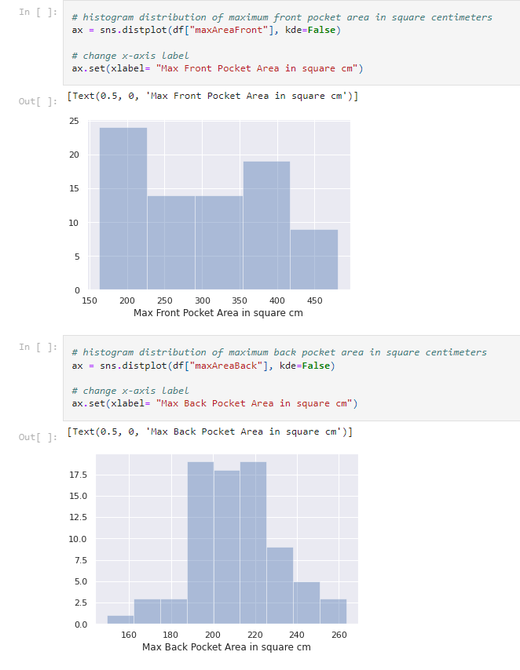
Exploratory analysis
I confirmed normal distribution using histograms of the maximum pocket area for both front and back pockets

Slide 15
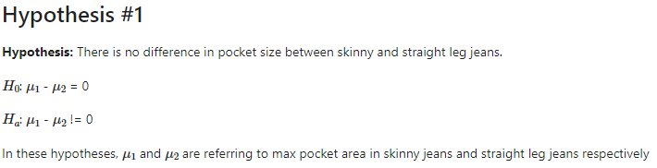
Testing hypothesis one

Slide 16

Testing hypothesis one
To test the hypothesis that there is no difference in pocket size between skinny and straight leg jeans I first split the DataFrame into two sample populations, skinny and straight

Slide 17
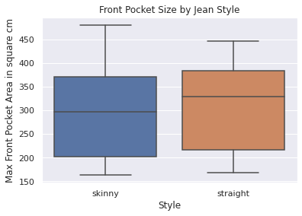
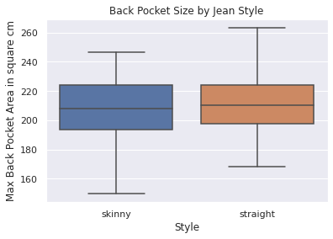
Testing hypothesis one
First, I want to look at the distribution of the values for the front and back pocket area between skinny and straight leg jeans
From these box plots you can see these two styles look to have very similar pocket sizes. We’ll know for sure after running the t-tests

Slide 18
hypothesis one conclusion
After running the independent samples t-tests for front and back pocket sizes between skinny and straight leg jeans, the results weren’t entirely unexpected after looking at the box plots from earlier

Slide 19
hypothesis one conclusion
After running the independent samples t-tests for front and back pocket sizes between skinny and straight leg jeans, the results weren’t entirely unexpected after looking at the box plots from earlier
For the front pocket size, our test resulted in a p-value of 0.6920785003547107, and a standard deviation value of 0.397508189103932
With these results, we can say with 95% confidence that we failed to reject our original hypothesis that there is no statistically significant difference in front pocket size between skinny and straight leg jeans

Slide 20
hypothesis one conclusion
For the back pocket size, our test resulted in a p-value of 0.2440388707334372, and a standard deviation value of 1.1738198976154692
With these results, we can say with 95% confidence that we failed to reject our original hypothesis that there is no statistically significant difference in back pocket size between skinny and straight leg jeans

Slide 21
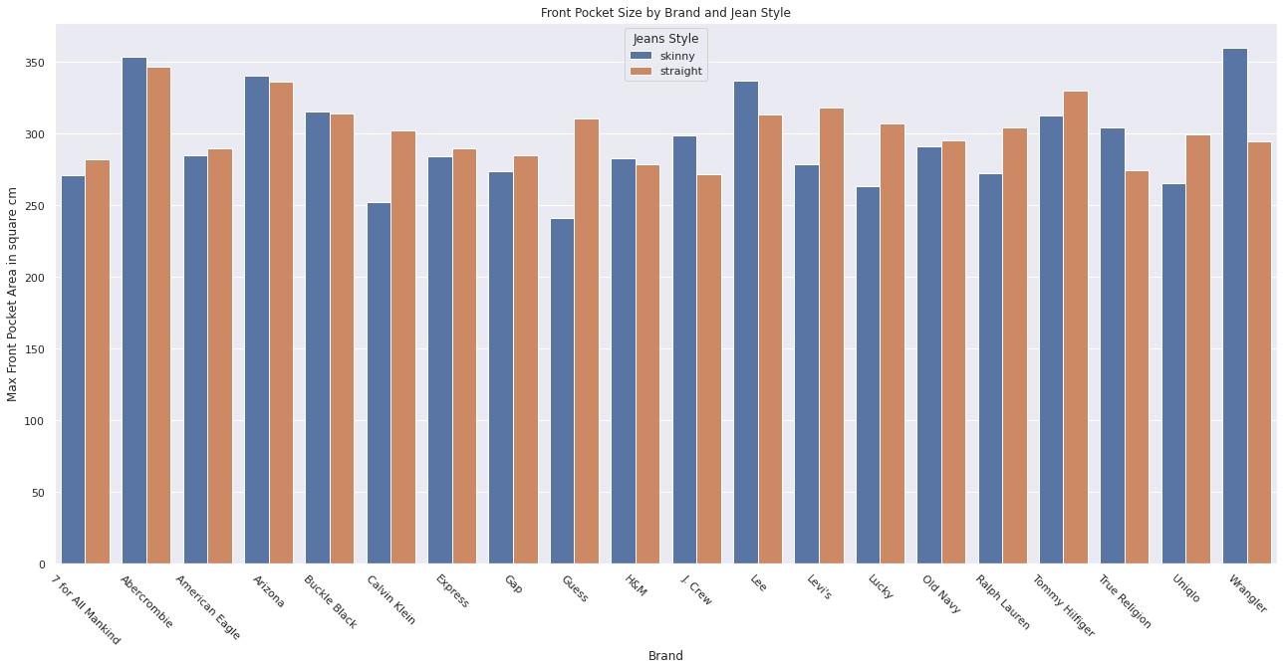
hypothesis one conclusion
As you can see from this bar plot, there is very little difference in front pocket size between these two style of jeans across all 20 brands that were measured for this study

Slide 22
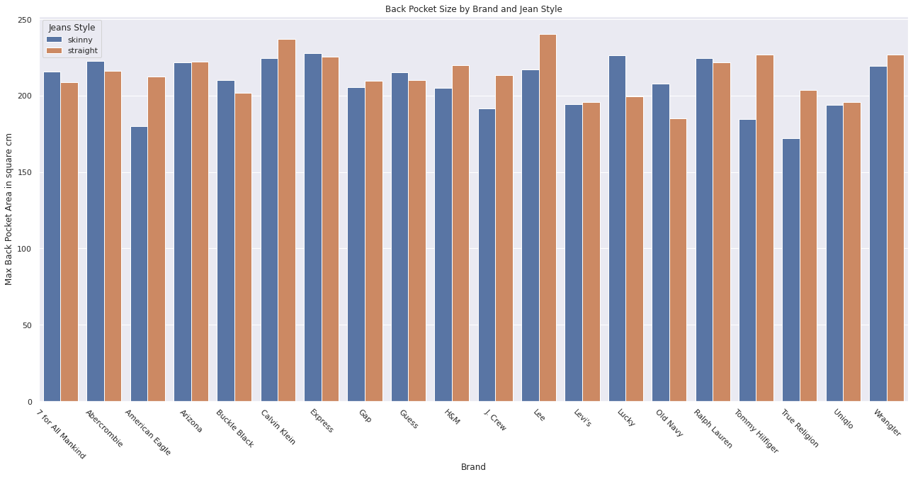
hypothesis one conclusion
As you can see from this bar plot, there is very little difference in back pocket size between these two style of jeans across all 20 brands that were measured for this study

Slide 23
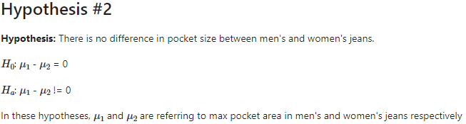
Testing hypothesis two

Slide 24

Testing hypothesis two
To test the hypothesis that there is no difference in pocket size between men’s and women’s jeans I first split the DataFrame into two sample populations, men and women

Slide 25
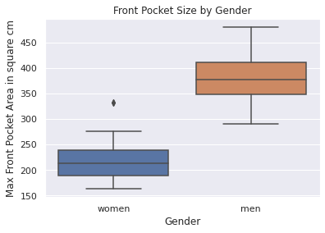
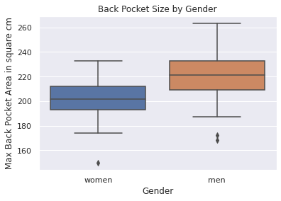
Testing hypothesis two
First, I want to look at the distribution of the values for the front and back pocket area between men’s and women’s jeans
From these box plots you can see that men’s pockets are much bigger than women’s are
Our t-tests will confirm this

Slide 26
hypothesis two conclusion
After running the independent samples t-tests for front and back pocket sizes between men’s and women’s jeans, the results weren’t entirely unexpected after looking at the box plots from earlier

Slide 27
hypothesis two conclusion
After running the independent samples t-tests for front and back pocket sizes between men’s and women’s jeans, the results weren’t entirely unexpected after looking at the box plots from earlier
For the front pocket size, our test resulted in a p-value of 2.7130561416957525e-28, and a standard deviation value of 17.217516127675193
With these results, we can say with 95% confidence that we can reject our original hypothesis that there is no statistically significant difference in front pocket size between men’s and women’s jeans
Men’s front pockets are bigger than women’s

Slide 28
hypothesis two conclusion
For the back pocket size, our test resulted in a p-value of 0.00011587923122639593, and a standard deviation value of 4.0597967872891125
With these results, we can say with 95% confidence that we can reject our original hypothesis that there is no statistically significant difference in back pocket size between men’s and women’s jeans
Men’s back pockets are bigger than women’s

Slide 29
hypothesis two conclusion
Now that we’ve proven there’s a statistically significant difference in pocket size between men’s and women’s jeans, let’s see if we can quantify that difference

Slide 30
hypothesis two conclusion
Now that we’ve proven there’s a statistically significant difference in pocket size between men’s and women’s jeans, let’s see if we can quantify that difference
I’ve already split the two recorded genders into separate populations, so I can write my own function to calculate the percent change between the mean pocket size values for each gender

Slide 31
hypothesis two conclusion
Now that we’ve proven there’s a statistically significant difference in pocket size between men’s and women’s jeans, let’s see if we can quantify that difference
I’ve already split the two recorded genders into separate populations, so I can write my own function to calculate the percent change between the mean pocket size values for each gender
Using this function, I found that:
On average, the front pockets in men’s jeans are 74% larger than in women’s jeans
Men’s back pockets are 9% larger on average

Slide 32
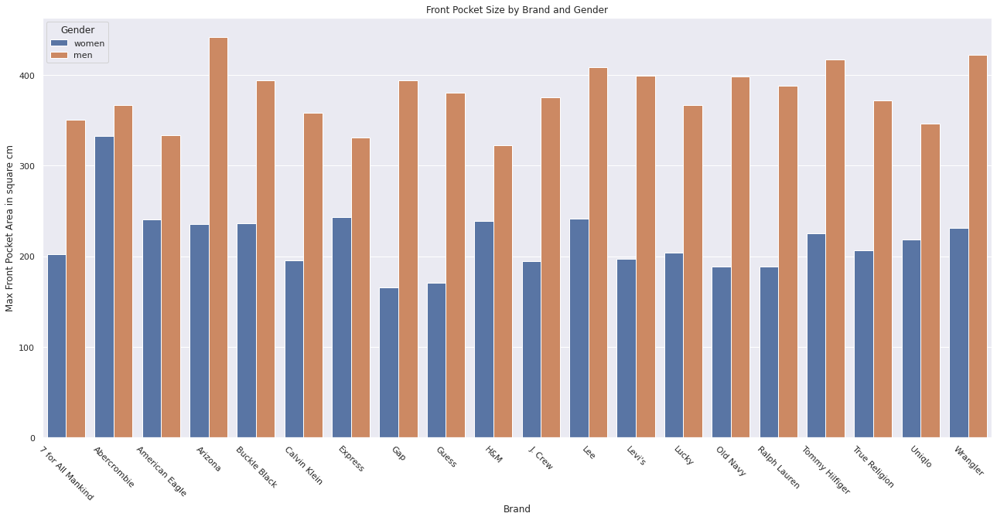
hypothesis two conclusion
As you can see from this bar plot, there is a significant difference in front pocket size between men’s and women’s jeans across all 20 brands that were measured for this study

Slide 33
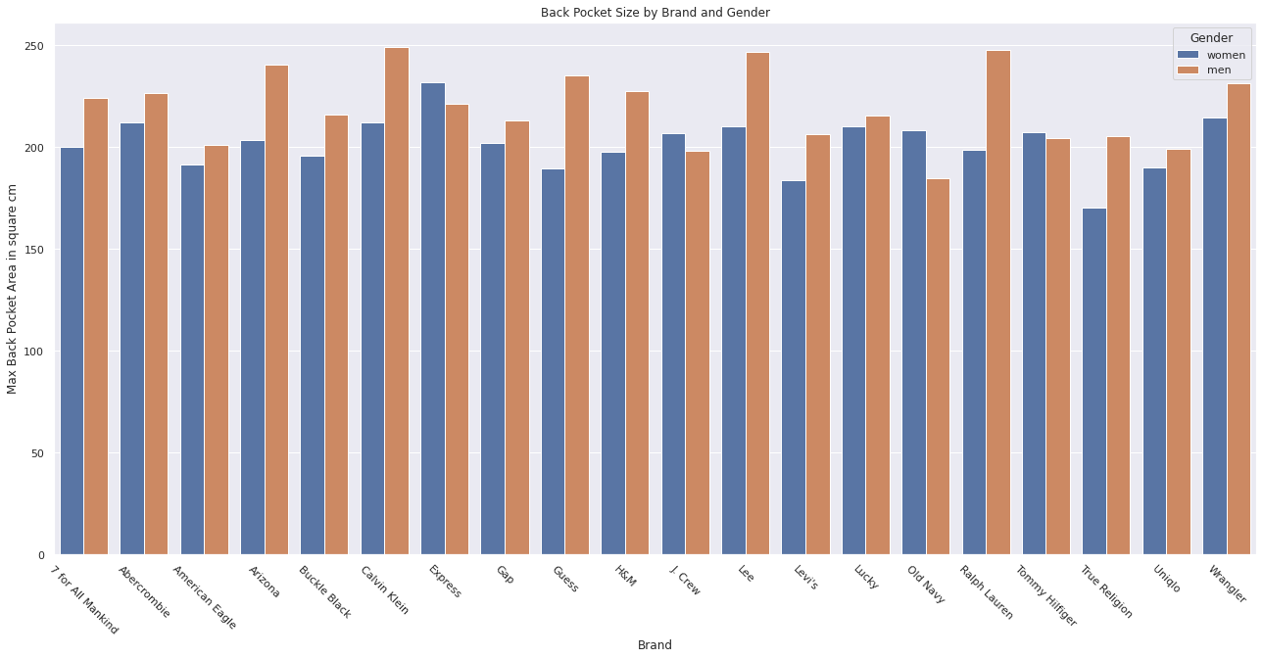
hypothesis two conclusion
As you can see from this bar plot, there is a difference in back pocket size between men’s and women’s jeans across the 20 brands that were measured for this study

Slide 34
conclusion
There is no statistically significant difference in pocket size between skinny and straight leg jeans
There is a statistically significant difference in pocket size between men’s and women’s jeans

Slide 35
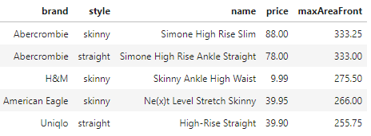
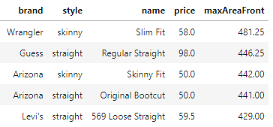
recommendations
These are the top 5 women’s jeans from the study in order of descending front pocket size
These are the top 5 men’s jeans from the study in order of descending front pocket size

Slide 36
recommendations
I recommend jeans manufacturers increase the pocket size in women's jeans. Not all women carry purses, so fake/no pockets or tiny pockets need to be a thing of the past. Women around the world want bigger pockets, social media has spoken! Until manufacturers catch on, women wanting jeans with bigger pockets could choose a pair from the top five list I created or try on a pair of men's skinny jeans

Slide 37

Questions?

